Slide 1

2015 National Agreement
Summary of Key Provisions for Workers, Managers and Physicians
September 30, 2015

Slide 2
Key Dates
Selected Timelines
National Agreement effective dates: Oct. 1, 2015 – Sept. 30, 2018
Local collective bargaining agreements roll over three years from their current expiration dates
Wage and benefit increases take effect: Oct. 1. 2015
Updated UBT targets and assessment process: Jan. 1, 2016
Changes to Total Health Incentive Plan: Jan. 1, 2016
Notes:
2
2
The National Agreement includes many deadlines and deliverables, all of which will be closely tracked by Labor Management Partnership leaders. These are just a few key dates.

Slide 3
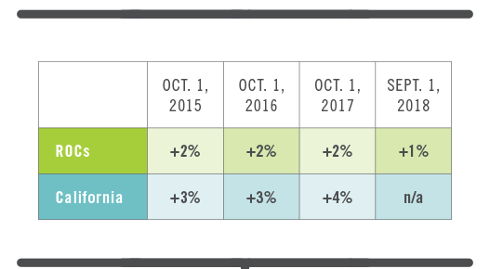
Benefits and Economics
Across-the-board wage increases
Notes:
3
3
All Coalition-represented employees in Northern and Southern California are getting 3 percent wage increases each year in the first two years of the agreement, and a 4 percent increase in the third year.
In Regions Outside California, employees will receive a 2 percent increase each year, plus additional 1 percent wage adjustment in the ROC regions at the end of the third year

Slide 4

Benefits and Economics
Active employee benefit changes include:
  Co-pays for ER visits ($50 in California and Northwest; $100 all other regions)
  No change to pensions or 401(k) plans for life of agreement
  Dental maximum increased to $1,500 per year*
  Lifetime orthodontia increased to $1,500 (per child)*
  Life insurance increased to $50,000
* Except in Northwest, which has no maximum
Notes:
4
4
Benefits for Coalition-represented employees remain excellent.
There is no change to active employees’ medical benefits except for co-pays for emergency room visits.
Pension and 401(k) plans remain unchanged.
Dental, orthodontia, life insurance and tuition reimbursement benefits have improved, such that that all Coalition members will enjoy the same basic level of these benefits across all regions.

Slide 5

Benefits and Economics
Retiree medical benefits: A long-term solution
  Plan provides retirement benefits while reducing future liabilities
  Future retirees and their spouses will enroll in a KP Senior Advantage individual plan, and KP will provide premium subsidies
    For California employees who retire on or after January 1, 2017, changes will take effect no sooner than 2028
    For ROC employees who retire on or after January 1, 2017, changes will take effect upon their retirement
  Health Reimbursement Accounts will cover most out-of-pocket expenses
Notes:
5
5
The agreement maintains the post-retirement benefit structure, while reducing liabilities associated with these benefits.
Coalition retirees will transition from their current plan into the KP Senior Advantage plan that is offered to all KP Medicare members.
To make this change cost-neutral for most retirees, the agreement creates Health Reimbursement Accounts that retirees can use to cover most of their out-of-pocket expenses.
These new HRAs will be funded by KP based on years of service. They are separate and apart from the HRAs that some employees have in connection with their unused banked sick leave.
The change-over starts for ROC employees who retire after 1/1/17. In California, the new plan takes effect no sooner than 2028.

Slide 6
Total Health and Workplace Safety
Total Health Incentive Plan
Joint expert
team to analyze current program; create 2016 THIP
One gate:
$150 payout for screenings*
Second payout: $350 for health outcomes
*Total Health Assessment (THA) being phased out starting in 2016. Biometric screenings to include BMI, blood pressure, cancer screenings, smoking.
Notes:
The Total Health Incentive Plan will continue as part of our strategy to jointly build the healthiest workforce in health care. But the incentive plan will change in some ways.
Biometric screenings will be the first gate for earning a payout. The required screenings have changed slightly and will include BMI, blood pressure, smoking and certain cancer or chronic disease screenings.
A second and larger payout will be made in regions that achieve collective outcomes in each of those health measures.
A joint team will analyze the current program and make recommendations about the appropriate health outcome goals for earning the payout.
The Total Health Assessment will no longer be part of the Total Health Incentive Plan payout package as of Jan. 1, 2016. However, it remains in the plan till the end of 2015, to be paid in 2016 for regions that meet that goal.

Slide 7
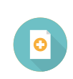
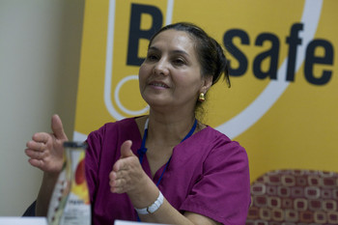
Total Health and Workplace Safety
Reduce workplace injuries and violence
  Assess current workplace safety investments and provide guidelines for regional and local implementation
  Enhance tracking of safety hazards
  Jointly prepare for emergencies
  Pursue proactive ergonomics program
  Organization-wide workplace violence
  analysis and prevention efforts
  Evaluate the effectiveness and implementation of the IDM program, with the goal of keeping people working
  Engage coalition unions in Community Benefit programs
Notes:
Several provisions will provide closer union and management engagement in efforts to improve workplace health, safety and wellness.

Slide 8
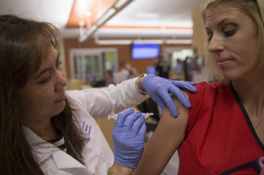
Total Health and Workplace Safety
Patient Safety: Flu Prevention
As of October 1, 2015, workers required to get seasonal flu vaccine or wear a surgical mask during flu season while working in patient care areas
Notes:
To enhance patient safety, workers will be required to get seasonal flu vaccine or wear a surgical mask during flu season while working in patient care areas

Slide 9

Work of the Future
More resources for worker training
  Contributions to Ben Hudnall Trust Fund and SEIU Joint Employer Education Fund increased 33 percent (from 0.3 percent to 0.4 percent of gross annual payroll of participating employees)
  Additional $1 million per year to each fund to support and train employees going through redeployment
  Tuition reimbursement raised to $3,000 per year, to assist workers who have had to put up money in advance. Applies to all regions.
Notes:
The agreement allocates additional resources to assist with redeployment of Coalition-represented workers whose jobs may be affected by workplace changes.
KP contributions to the Ben Hudnall Trust Fund and SEIU-UHW Joint Employer Education Fund increased by 33 percent.
An additional $1 million per year will go to each fund to support workers going through redeployment
Tuition reimbursement for outside training programs has been raised to $3,000 per year. This applies to all regions.

Slide 10
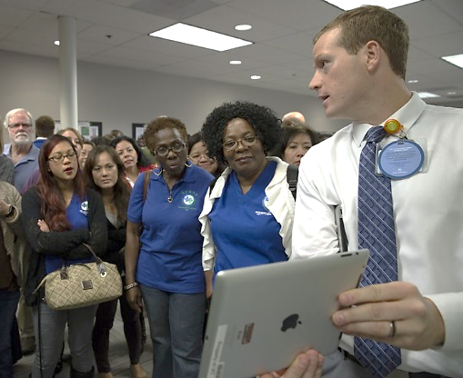
Work of the Future
Remove barriers to career development and mobility
  Regions will work with unions to identify training opportunities to help employees meet minimum experience requirements
  Collaborative, transparent redeployment process
  Preceptor programs and mentorships
  Joint system to capture core competencies, skills, education, licensure, certification, and work experience
Notes:
Regions will work with Coalition unions to identify training opportunities to help employees meet minimum experience requirements.
There will be a collaborative, transparent process for managing redeployment of workers.
Preceptor programs and mentorships will help KP employees build skills, overcome barriers and move into the KP jobs of the future.
KP has committed to enhance opportunities for union career mobility, and is developing a joint system to capture core competencies, skills, education, licensure, certification, and work experience.

Slide 11
Operations and Partnership
UBT Assessment Process
Teams will be evaluated during face-to-face assessment meetings:
  Level 1-3 teams every quarter.
  Level 4 and 5 teams once a year or more if necessary
Face-to-face assessments will be conducted by the team's UBT consultant and union partnership representative. Sponsors must sign off but do not need to be present at the assessment meetings.
An action plan will be developed that gives the team clear guidance on steps it needs to take to move up the Path to Performance.
Notes:
Several new provisions of the agreement will bring more consistency and rigor to UBT assessment and development
This includes face-to-face assessments of teams, on a regular basis, to ensure accurate ratings.
There also will be action plans and follow-up to ensure that teams are progressing on the Path to Performance.

Slide 12
Operations and Partnership
Flexibility
Regional subgroups to address flexibility, guided by Value Compass, to address KP member/patient needs
Commitment to operational flexibility while relying on regular full-time and part-time staff to greatest extent possible
Notes:
The agreement sets out ways to provide greater operational flexibility, in partnership.
LMP Councils in each region will appoint labor and management representatives to address flexibility-related issues in their region.
The groups will jointly review and recommend approaches that have worked in one area and can be spread more widely to achieve flexibility and work-life balance.
They will report on their progress annually to the Executive LMP Council, and will seek assistance from LMP leadership as needed.
The parties also agreed to rely on regular full-time and part-time staff to the greatest extent possible.

Slide 13
Operations and Partnership
Path to Performance Revisions
UBTs incorporate Total Health and Workplace Safety:
  Level 1: Team identified health and safety champion
  Level 5: Team demonstrates culture of health and safety
Additional challenges for Level 5 teams:
  Spread or adopt a successful practice
  Get the voice of the KP member/patient
Additional process improvements:
  UBT Tracker to be updated every 90 days
  More clarity for sponsors on how to best support their teams
Notes:
The agreement updates the UBT Path to Performance in several ways to strengthen unit-based team effectiveness.
For instance, UBTs will be working with a team health and safety champion.
There are also updated criteria for teams to be rated high-performing.
Level 5 teams will have to show they are spreading or adopting successful practices. Member-facing departments will have to get input from the voice of their customers.
And all teams will need to update their progress in UBT Tracker every 90 days.

Slide 14
Operations and Partnership
Annual goals for percent of teams
to reach high performance
Year | Levels 4 & 5
2016 | 75%
2017 | 80%
2018 | 85%
2019 | 87%
Notes:
Recognizing the additional demands being placed on teams, the parties agreed to recalibrate the annual performance targets for UBTs.
This chart shows the new targets thru 2019.

Slide 15

Operations and Partnership
Create a scorecard to measure Partnership performance at the facility/area and regional level
Examples of metrics may include, but are not limited to:
  Active LMP Councils
  Service scores
  UBT levels
  Culture of health and safety
  Attendance
  Support for LMP and UBTs
  People Pulse scores
  Problem solving (number of
  disputes, time to resolve, etc.)
Notes:
To ensure greater consistency in partnership, the agreement provides for the creation of scorecards to assess all aspects of partnership at the region and facility level.
These scorecards will be developed and implemented for facilities, service areas or regions by Q4 2016.
This list shows examples of some metrics that might be used to assess partnership effectiveness.

Slide 16
Improved Dispute Resolution
Dispute resolution process to address issues more quickly, at the lowest appropriate level
Facility representatives
Local LMP Council
LMP
Regional Council
National
LMP Leadership
National LMP Panel
Notes:
16
16
The dispute resolution process for questions pertaining to Section 1 of the National Agreement – Privileges and Obligations of Partnership – has been streamlined.
When disagreements arise at the facility level, the parties directly involved will meet and use interest-based problem solving to try to resolve the issue at that level.
If they cannot do that within 30 days, the issue will be referred to local LMP Council. If there’s still no resolution, it will go the Regional Council, and so on. Everyone will have just 30 days to resolve the issue at each level.
If no solution can be agreed to, the question will be decided by a panel including a neutral designee.

Slide 17
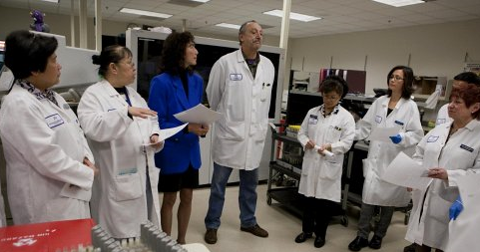
Building Future Capacity
LMP Learning: LMP learning experts from across regions to conduct an inventory and assessment of current approaches to LMP learning. New learning modalities and approaches will be piloted in 2016.
UBTs of the Future: LMP Executive Committee will sponsor work related to the "UBT of the Future.” By mid 2016, regional representatives will identify the attributes and criteria for "UBT of the Future.”
Notes:
Other provisions include a program to be launched in 2016 to help develop the work of UBTs of the Future.
Also in 2016 there will be a joint assessment of LMP training programs and approaches, and new partnership training approaches will be piloted.

Slide 18
For More Information
To learn more about the bargaining process and issues addressed in the 2015 National Agreement, visit Bargaining2015.org
To learn more about our Labor Management Partnership, visit LMPartnership.org

