Slide 1
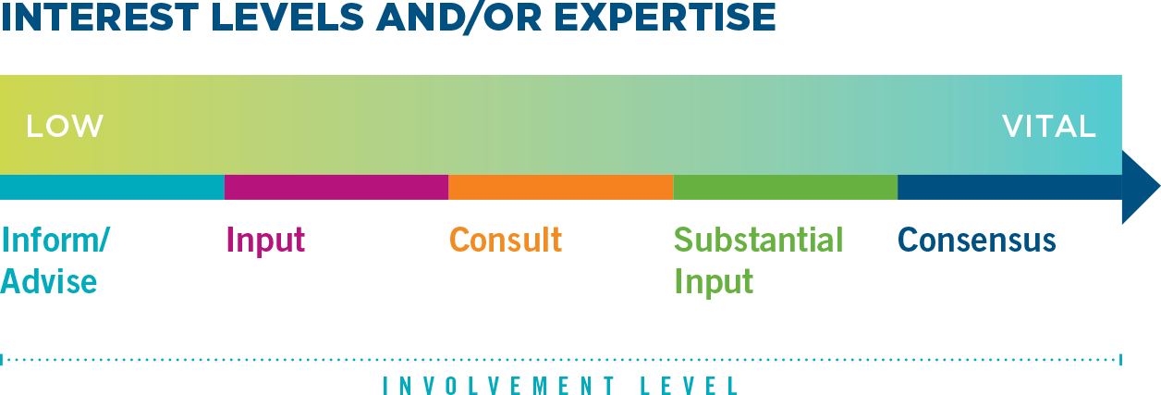
CONSENSUS DECISION MAKING CONTINUUM
The cornerstone of our shared vision for a high-performance workplace: Employees will increasingly make more decisions regarding how the work is accomplished.
We should seek consensus on workplace decisions that especially affect systemic changes in how the work is organized and carried out.
Use this chart to determine which type of decision making is appropriate for the situation:

